Slide 1


WHO IS AFFECTED?
TEAM
MindMesh
Target users, stakeholders, beneficiaries
Primary users / target group
Individuals with limited AI awareness, especially students, job seekers, small business owners, rural users, and first-time AI users who need guidance in choosing and using the right AI tools for their needs.
Secondary stakeholders
Colleges, Training Centers, Employers, local Organizations and clubs meant for different community needs.
Who benefits if the problem is solved?
Every individual seeking guidance on when, where, and which AI tool to use can benefit from this solution. It helps them save time, improve productivity, and make better use of AI.

Slide 2
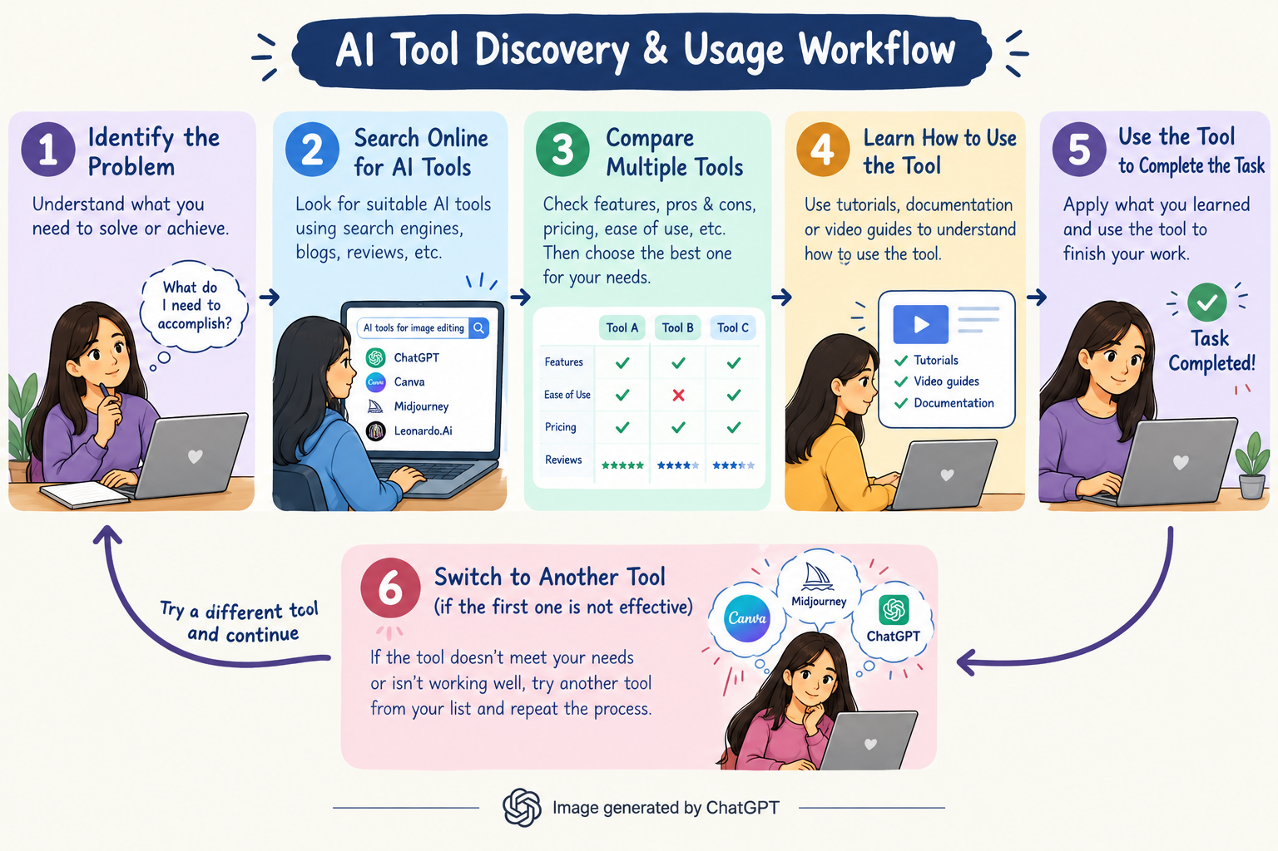
CURRENT SITUATION & CONTEXT
TEAM
MindMesh
Existing scenario, background and how things work today
Existing scenario and background: New AI tools are launching constantly, making it difficult to keep track of what is available. With so many new AI launching all the time, it is hard to find the truly useful one. Even after finding the right AI tool, Many people don’t know how to use it effectively.
Facts :There are thousands of AI tools available for different purposes. Information about AI tools is scattered across different websites, social media, and online platforms. Users often depend on search engines or social media to find suitable tools.

Slide 3
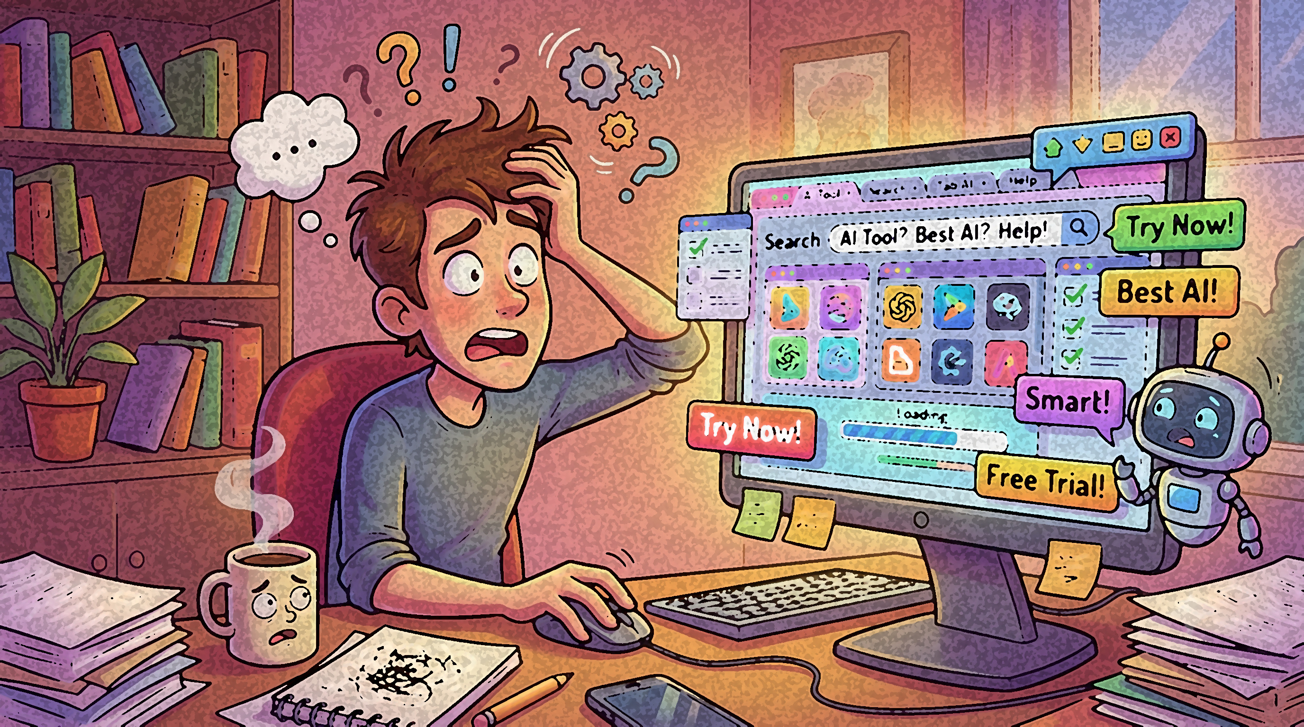

KEY CHALLENGES
TEAM
MindMesh
Main difficulties, bottlenecks, root causes and consequences
Main difficulties and bottlenecks:
  As there are too many AI tools , people struggle to choose the right one.
  Users often spend time experimenting with multiple tools.
  Users stick to one AI tool without knowing that other tools could better meet their needs.
Root causes behind them:
  AI technology is evolving faster than people can learn to use it.
  There is no specific guidance on which tool suits a specific task.
Consequences of leaving them unsolved:
  Time and effort are wasted searching for suitable tools.
  People will spend money on unwanted AI courses.
  People use the wrong AI tools, leading to poor results and discouraging them from further use.

Slide 4
EXISTING SOLUTIONS / APPROACHES
TEAM
MindMesh
What is already being done, and where it falls short
Existing methods, systems or alternatives:
  People use AI tool directories and websites(Eg:AIxploria) for their needs.
  YouTube videos, blogs and asking a chatbot(Eg:ChatGPT)
Limitations of each:
  Directories: huge lists, confusing for beginner
  Videos and blogs: quickly outdated, sometimes sponsored
  Chatbots: may suggest outdated or biased tools
The gap they leave open (Key Challenges):
  No single website to easily find AI tools, learn how to use them, and get help from experts when they are stuck.
  Existing solutions help users discover AI tools, but do not simplify the process of choosing the right tool for the right task.

Slide 5
PROBLEM INSIGHTS & OPPORTUNITY AREAS
TEAM
MindMesh
Resources required to solve the problem
Hardware Requirements:
  Laptops or Desktops, standard network connections and smart phones
  Cloud/server infrastructure for hosting the platform.
Software Requirements:
  Websites, Flutter or React Native to build the app.
  Python or Java Script, Database, Payment apps, Designing apps, GitHub for Version control.
Other resources (Including Human Resources):
  Mobile App or Website developer to build the Android and iOS app.
  Expert service providers, freelancers and job seekers to complete client's tasks.
  Marketing and social media manager to bring in users and clients.
  Data Engineer, back-end developer, AI/ML engineers, Data Analyst, Cybersecurity specialist.

Slide 6
INITIAL DIRECTION & EXPECTED OUTCOME
TEAM
MindMesh
What Is Your Expected Outcome?
What your team intends to do:
  Build a platform that recommends suitable AI Tools with step -by -step guides and sample prompts.
  Allow individuals and businesses to request AI assisted services directly through our platform.
  Create earning opportunities for people with AI skills
What you want to improve:
  Reduce confusion and time spent searching for AI tools
  Increase awareness of AI tools and their features and Improve access to AI assisted services for individuals and businesses
What successful improvement should you achieve:
  Help users identify the right AI tool within minutes and keep useful AI tools updated across various fields.
  Make it as a go-to platform for AI tool discovery and expert assistance.

